Slide 1


Slide 2
The time and work is the basis of how work gets done at a particular time. The problems with time and work give us the exact relationship between those who are working and the time it takes to fulfill the work.
Going by basic mathematical definitions, time can be defined as the duration during which a certain activity takes place, whereas work is defined as the set of tasks completed to achieve a desired activity or result. It goes without saying that to complete a work, an amount of time is consumed. It means that there exists a certain relation between time and work.

Slide 3
Time: Time is the duration during which any activity or work happens or continues.
Work: Work is a task or set of activities to achieve a certain result.
We can define happening of work as:
If a person A completes a work in X days, then the amount of work completed by him in 1 day will be = 1/X
Similarly, if a person B completes work in Y days, then the amount of work completed by him in 1 day will be = 1/Y
From the above two points, we can say that in one day A and B together can complete (1/X + 1/Y) amount of work. Thus, together A and B can complete the work in XY/X+Y days.

Slide 4
Let us understand the concept through a question
Example 1 : - The time taken by Ram and Shyam alone to complete a piece of work is 24 days and 40 days, respectively. What is the time taken by Ram and Shyam together to complete the same amount of work?

Slide 5
Solution: -
Ram complete the whole work in 24 days
So, part of the work done by Ram in one day = 1/24
Shyam complete the whole work in 40 days
So, part of the work done by Shyam in one day = 1/40
Therefore, one day work of Ram and Shyam together will be
1/24 + 1/40 = 8/120
As Ram and Shyam together can complete 8/120 part of the work in 1 day
So, time taken by Ram and Shyam together to complete the work will be = 120/8 = 15 days

Slide 6
Example 2: P and Q can complete a job in 12 days working together. If P alone can complete it in 20 days, in how many days
can Q alone complete it?
32
24
20
30
Notes:
Answer A

Slide 7
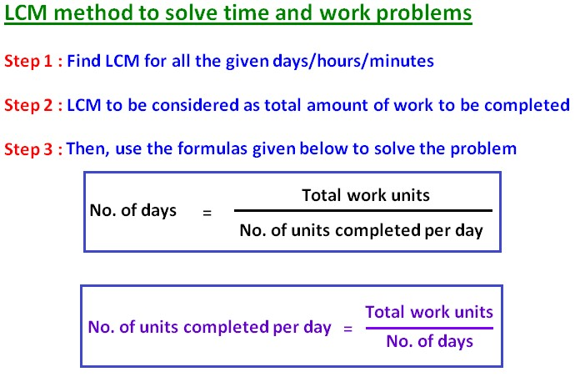
Alternative Method:
Work done = Efficiency × Time taken

Slide 8
Example: The time taken by Ram and Shyam alone to complete a piece of work is 24 days and 40 days, respectively. What is the time taken by Ram and Shyam together to complete the same amount of work?

Slide 9
Solution
Step 1: Assuming a total work Let us assume the total work be LCM of (24 and 40) = 120 units
Step 2: Calculating the efficiency of each individual We know, Work done = time taken × Efficiency(or one-day work)
⇒ Efficiency of Ram = 120/24 = 5 units/day
⇒ Efficiency of Shyam = 120/40 = 3 units/day
Step 3: Calculating the combined efficiency
Efficiency of Ram and Shyam together will be = 5 + 3 = 8 units/day Now,
Time taken by Ram and Shyam to complete the work = Total Work / Efficiency
⇒ 120/8 = 15 days

Slide 10
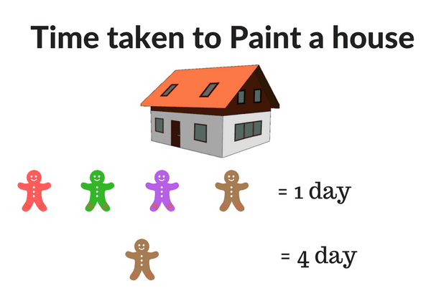
Concept of Efficiency
Efficiency denotes the amount of work done by any person in 1 day.
The ratio of the efficiencies of two workers is inversely proportional to the time taken by them to complete a work.
If a worker is less efficient than he/she will take more time to complete the work.
If a worker is more efficient than he/she will take less time to complete the work.
The number of workers is inversely proportional to the time taken to complete the work

Slide 11
Example: - A is 3 times as efficient as B. If B alone can complete the work in 12 days, then A alone can complete the work in how many days?

Slide 12
Solution: - According to the question, the ratio of the efficiency of A and B is 3 : 1
We know that the ratio of the efficiency is inversely proportional to the ratio of the time taken
So, the ratio of the time taken by A and B to complete the work will be 1 : 3
Let us assume A alone completes the work in x days and B alone completes the work in 3x days
3x = 12
x = 4
Therefore, A alone can complete the work in 4 days.

Slide 13
Example: f X is 40% more efficient than Y, find the ratio of the efficiencies of X and Y.
5 : 3
3 : 5
5 : 7
7 : 5
Notes:
Answer- B

Slide 14
Leaving and Joining type:
Example: A can do a bit of work in 25 days which B can complete in 20 days. Both together labor for 5 days and afterward A leaves off. How long will B take to complete the remaining work?
Notes:
Answer- B

Slide 15








Leaving and Joining type:
Example: A can do a bit of work in 25 days which B can complete in 20 days. Both together labor for 5 days and afterward A leaves off. How long will B take to complete the remaining work?
Solution: Total Work
0 100 A=25
0 5days 45 B=20
45 11days 100
Total Efficiency= 9
(A+B)'s 5 days work = 5*9=45 units of work
Remaining work = (100-45) = 55 units of work
So, the remaining work will be done by B only.
55/5 =11 days
Notes:
Answer- B

Slide 16
Example: A can do a piece of work in 20 days and B in 30 days. A starts the work and worked for 6 days. Then B completed the remaining part of the work. In how many days was the work completed?
24
27
32
34
Notes:
Answer- A

Slide 17
A, B and C working alone, can complete a work in 8 days, 12 days and 24 days respectively. All the three of them started the work and then A left after 2 days. B left after another 3 days and C then completed the remaining work. If the total wages earned by the three of them is 6000, then find the share of A.
(a) 450
(b) 600
(c) 800
(d) 1500

Slide 18
Working on alternate days
Example: A can do some work in 10 days, B can do the same work in 5 days. If they are working on alternate days, In how much time the work will be done.

Slide 19
Working on alternate days
Example: A can do some work in 10 days, B can do the same work in 5 days. If they are working on alternate days, In how much time the work will be done.
Solution: A=10 1
10
B=5 2
Total Work=10 units
A start the work and complete 1 unit of work, and on the next day B will complete 2 units of work. In 2 days 3 units of work be done. In 6 days 9 units of work will be completed. On the 7th day A will complete the remaining work.
In 7 days whole work will be completed.

Slide 20
Example: A, B and C can do a piece of work in 20, 30 and 60 days respectively. In how many days can A do the work if he is assisted by B and C on every third day?
12 days
15 days
16 days
18 days
Notes:
Answer - B

Slide 21
Negative Work Done:
Example: A can do some work in 5 days, B can destroy the same work in 10 days. If they are working together, In how much time the work will be done.
.
Notes:
Answer - B

Slide 22
Negative Work Done:
Example: A can do some work in 5 days, B can destroy the same work in 10 days. If they are working together, In how much time the work will be done.
Solution: A=5 2
10
B=10 -1
A can complete 2 units of work in 1 day, B can destroy 1 unit of work in the same time. If they are working together they can complete 1 unit of work in 1 day.
10 units of work will be completed in 10 days.
Notes:
Answer - B

Slide 23
Example: A can do some work in 5 days, B can do the same work in 8 days, C can destroy it in 10 days. If they are working together, In how much time the work will be done.
40/9 days
20/3 days
5 days
16/3 days
Notes:
Answer - A

Slide 24
Constructive and destructive work on alternate days:
Example: A can do some work in 2 days, B can destroy the same work in 3 days. If they are working on alternate days ,In how much time the work will be done.

Slide 25
Constructive and destructive work on alternate days:
Example: A can do some work in 2 days, B can destroy the same work in 3 days. If they are working on alternate days ,In how much time the work will be done.
Solution: A=2 6 3 0 Total work=6 6
B=3 -2 0 3 6 0 3-2=1 6 0 1+3=4 6 0 4-2=2 6 0 2+3=5 6 0 5-2=3 6 0 3+3=6 6
A will complete 3 units of work in 1 day and B will destroy 2 units of work on the next day.
In 2 days 1 unit of work will be completed, and they will complete 3 units of work in 6 days. On the 7th day A will work and complete the remaining work.

Slide 26
Example: A can do some work in 10 days, B can do the same work in 15 days, C can destroy it in 12 days. If they are working together, In how much time the work will be done.
58 days
57 days
59 days
None of these
Notes:
Answer - D

Slide 27
Practice
Questions
Notes:
Answer - D

Slide 28
1. A and B working together can complete a job in 30 days. The ratio of their efficiencies is 3 : 2. In how many days can the faster person complete the job?
30
40
50
60

Slide 29
2: P and Q completed a job working together in x days. P takes (x 1 /8) days to complete the job, Q takes (x 1 /18) days to complete the job. Find x.
8
12
16
20

Slide 30
3: P and Q can complete a job in 12 days working together. Q and R can complete the job in 20 days working together. P and R can complete the job in 15 days working together. In how many days can P, Q and R complete the job
working together?
5
10
15
20

Slide 31
4: A can do a piece of work in 20 days and B in 30 days. A starts the work and worked for 6 days. Then B completed the remaining part of the work. In how many days was the work completed?
24
27
32
34

Slide 32
5: A can do a piece of work in 24 days and B in 48 days. B joins A after A had worked alone for 6 days. In how many more days would the work get completed?
10
11
12
13

Slide 33
6: Rajesh and Rakesh working alone can complete a piece of work in 12 and 24 days respectively, Rajesh started the work and after a few days Rakesh joined him and the work was completed in 10 days. After how many days, did
Rakesh join Rajesh?
6
7
8
10

Slide 34
7: A and B can do a piece of work in 15 days and 20 days respectively. They worked on alternate days with A starting the work. In how many days will the work be completed?
8 days
10 days
17 days
None of these

Slide 35
8: A and B working separately can do a piece of work in 10 days and 15 days respectively. If they work on alternate days beginning with A, in how many days will the work be completed ?
18 days
13 days
12 days
6 days

Slide 36
9: P can complete a piece of work in 20 days and Q in 30 days. P worked alone for 4 days and then Q completed the remaining work along with R in 18 days. In how many days can R working alone complete the work?
60
65
80
90

Slide 37
10: A can complete a piece of work in 36 days. He worked for 6 days and left. The remaining work was then completed by B in 40 days. In how many days would the work be completed if they work together?
16 2/7
18
20 4/7
None of these

Slide 38
11: A can complete a job in 2 days. B can complete the job in 4 days. If they work on alternate days, the job would be
completed in the
(a) least possible time, if A starts the job.
(b) least possible time, if B starts the job.
(c) same time, irrespective of who starts the job

Slide 39
12: A can do a piece of work in 70 days and B is 40% more efficient than A. The number of days taken by B to do the same work is
40 days
60 days
50 days
45 days

Slide 40
13. If 30 men can do a job in 30 days, find what part of the job can be completed by 1 man in 1 day.
1/30
1/900
1/90
None of these

Slide 41
14. A can do some work in 20days, B can destroy the same in 30 hrs. In how much time the work will be done. If they are working on alternate days.
60days
120 days
119 days
None of these

Slide 42
15. A and B can complete a piece of work in 15, 25 days respectively and C can destroy the same work in 30 days. A and B Work on alternative days and C works daily. In what time they completed work
50
100
25
30

Slide 43
16. A can complete a piece of work in 15 days and B can destroy the same piece of work in 20 days. Then in how many days the work will be completed if they are working together?
30 days
45 days
60 days
None of these

Slide 44
Lecture – 2
Work and Wages
The Concept of work and wages is used to compare the work with the remuneration for the work. The wages for any amount of work is directly proportional to the work done.
If all the workers work for the same number of days, then their wages are in the ratio of their efficiencies.
If all the workers have the same efficiencies and do the work for the different number of days, then their wages are distributed in the ratio of the number of days for which each of them worked.
If the workers have different efficiency and do the work for the different number of days, then their wages are in the ratio of the work done by them.
Notes:
Answer - D

Slide 45
Example: A can fabricate a divider in 30 days , while B alone can assemble it in 40 days, If they construct it together and get an installment of RS. 7000, what B's offer?
Solution:
A's 1 days work = 1/30,
B's 1 day work = 1/40,
Proportion of their shares = 1/30:1/40 = 4:3
B's offer = (7000*3/7) = Rs. 3000

Slide 46
Example: X can complete a job in 30 days. Y can complete the job in 60 days. Both work together along with Z to complete the job in 10 days. Find the share of Z in a total of Rs 6000 paid for the work.
Rs3000
Rs4000
Rs6000
Rs8000
Notes:
Answer - B

Slide 47

MDH formula/ Chain Rule
It is used to compare the works of the same nature done at two different times using different manpower. The MDH formula can be represented as
Where M denotes the number of men/women/boys, D denotes the number of days, H denotes the number of hours in a day, E denotes the efficiency of 1 man, and W
denotes part of work done
Let us understand the application of this formula using a question

Slide 48

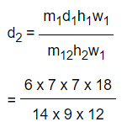
Example: 6 men can pack 12 boxes in 7 days by working for 7 hours a day. In how many days can 14 men pack 18 boxes if they work for 9 hours a day?
Solution: If 'w1' work is done by 'm1' men by working for 'h1' hours per day in 'd1' days & 'w2' is work done by men 'm2' working for 'h2' hours per day in 'd2' days, then
Since we need to find 'd2', we can re-arrange the formula as,
= 3.5 days

Slide 49
Example: . 30 men working 7 hours per day can do a piece of work in 18 days. In how many days can 21 men working 8 hours
a day do the same piece of work?
22 3/5
22 2/5
22 ½
None of these
Notes:
Answer - C

Slide 50


Provision of Food/ Fort Case
If food is available for ‘a’ days for ‘A’ men at a certain place and after ‘b’ days. ‘B’ men join, then the remaining food will serve total men for
Required time = days
If food is available for ‘a’ days for ‘A’ men at a certain place, and after ‘b’ days ‘B’ men leave then the remaining food will serve remaining men for
Required time = days

Slide 51
Example: In a Fort, 300 soldiers had of food provision for 90 days. after 20, days 50 soldiers left the Fort. how long would the last at the same rate?

Slide 52
Solution: In a Fort, 300 soldiers had of food provision for 90 days.
After 20 days, 50 soldiers left the Fort, So, the remaining soldiers 250 had the food for x days.
As soldiers increases the number of days for consuming the food decreases, it represents the indirect proportion.
So, 300 / 250 = x / 70 (Since, 90−20=70 days)
⇒x=300 / 250 × 70
∴x=84 days.
So, 250 men can have food for 84 days.

Slide 53
Example: 25 men take 20 days to construct a wall 10 m high. How many men would be required to construct a similar wall, which is 8 m high, if it is planned that the work would be completed in 10 days?
32
40
44
48
Notes:
Answer - B

Slide 54
Practice Questions
Notes:
Answer - B

Slide 55
1. Two men and seven boys can do a piece of work in 14 days, whereas three men and eight boys can do it in 11 days. In how many days can eight men and six boys do a piece of work which is three times the first?
20
22
21
None of these
Notes:
Answer - A

Slide 56
2. Three friends Gerard, Runey work together to dig a hole. Gerard alone can complete the work in 10 days and together they can complete it in 4 days. They earn a total of Rs.1,200. Find the share of Runey if the money that they receive is proportional to work that they do?
A] Rs 720
B] Rs 165.51
C] Rs 500
D] Rs 600
Notes:
Answer -

Slide 57
3. A piece of work can be completed by ten men in a certain number of days. If there were two men less it would have taken three more days to complete the work. In how many days can 24 men complete the same work?
2
3
4
5
Notes:
Answer -

Slide 58
4. 20 workers can reap 120 acres of land in 30 days working 6 hours a day. How many more acres of land can 30 workers working 12 hours a day reap in 15 days?
180
60
120
80
Notes:
Answer -

Slide 59
5. A man, a woman and a boy can do a piece of work in 3, 4 and 12 days respectively. How many boys must assist one man and one woman to complete it in one and half days?
12
6
1
3
Notes:
Answer -

Slide 60
6: 20 men can finish a piece of work in 30 days. After how many days should 5 men leave the work so that it is finished in 35 days?
5
15
10
12
Notes:
Answer -

Slide 61
7. A group of 25 workers are assigned a task of 330 units. Each worker can do 1 unit / day. They start the task. After every day one more worker joins the group. The task is completed in x days. Find x.
10
9
11
12
Notes:
Answer -

Slide 62
8. In a farm, 50 hens give 200 eggs in 2 days. In how many days, will 20 hens give 400 eggs?
A] 15
B] 10
C] 5
D] 8
Notes:
Answer -

Slide 63
9. 3 men and 5 women can complete a work in 12 days, which 5 men and 12 women can complete in 6 days. In how many days can 4 men and 4 women complete the same work?
7
10
11
12
Notes:
Answer -

Slide 64
10. Babli alone can do a piece of work in 10 days Ashu alone can do it in 15 days. The total wages for the work in Rs.5000. How much should Babli be paid off they work together for entire duration of the work?
A] 5000
B] 4000
C] 3000
D] 2000
Notes:
Answer -

Slide 65
11. If 12 men or 24 boys can do a work in 66 days, the number of days in which 15 men and 6 boys can do it is
44
33
55
66

Slide 66
12. There is a group of persons each of whom can complete a piece of work in 16 days, when they are working individually. On the first day one person works, on the second day another person joins him, on the third day one more person joins them and this process continues till the work is completed. In how many days would the work get completed?
3 1/4
4 1/3
5 1/6
6 1/5

Slide 67
13. If 6 men and 8 boys can do a piece of work in 10 days and 26 men and 48 boys can do the same in 2 days, then the time taken by 15 men and 20 boys to do the same type of work will be :
5 days
4 days
6 days
7 days

Slide 68
14. Four persons A, B, C and D produced 256 pieces of item P in 8 hours. B is twice as efficient as A. D is 25% less efficient than A but is three times as efficient as C. How many pieces did B produce?
128
64
48
16

Slide 69
16. Work done by (x + 4) men in (x + 5) days is equal to the work done
by (x – 5) men in (x + 20) days. Then the value of x is
20
25
30
15

Slide 70
